Slide 1

Microsoft Relationship

Slide 2
Market Segments
Microsoft divides their sales teams into 3 business units
EOU (Enterprise Customers)
SMC (Mid Sized)
SMB (Unmanaged)
Large team
3408
Medium Team
10,000
Partner Lead
9,000,000

Slide 3
Types of Sellers
They have 3 distinct roles driving results related to their territories
Account Manager (AM):
Owns primary relationship
Responsible for Revenue target
Licensing Deals
Specialty Team Unit (STU)
Represents specific product portfolio
Paid to sell those only
Solution Sales
Customer Executive (CE)
Licensing agreement focused, renewals, net new EA’s
Licensing revenue

Slide 4
US SMC West Modern Work
Lee Loen Director, Modern Work
Don Pistulka
Johnny Lopez
Connie Barnes
Daniel Correa
Jeff DiMaio
Brendan Mervin
Azad Vyas
Bret Ustipak
Doug Kline
Jason Waite
Jon Horner
Jon Studsrud
Arsalan Ajani
Framan Khan
Jean-Francois Gilbert
Ryan Ding
Surya Radhakrishnan
William Greenlee
Sean Francis
Win Gbedemah
Tom Schauer
Enrique Contreras
Brittney Reeves
Andrew Paulhus
Mike Manjunath
Angie Stevens
Bill Leonard
Everest Wein
Gina Olson
Lori Martinez
Michelle Duarte
Ravi Soni
Thomas Aten
TBH
TBH
Grant Mjelstad
Hugh Collins
Kyle Bauman
Roderick Kelly
Ryan Granville
Tiffany Lewis
TBH
TBH
John Kayl
Jonathan Selvera
Marcus Pollard
Maridee Adler
Okem Okolo-Ebube
Russell Cude
TBH
TBH
Federico Reyes
James Glasgow
Joseph Utter
Kim Tunney
Tim Montpas
Vincent Smith
Brigitte Nelson
Sandee Sampson
Darien Freedman
Michael Bonner
Patrick Broadway
RJ Johansen
Notes:
This is the SMC MWP STU org, they have their leader, Lee Loen, and each region is covered by M1 leaders (second line), then each leader has 10 + reports. They are aligned by AM by region. Once we have the 25MAL it will be realigned in the Customer report.
If you are in presales or leadership, understanding which person maps to which key account we have is important to drive deployment related services by using the key programs.

Slide 5
How to connect with the MS sellers
Do:
Talk about the relevant solution which they align to
Bring customer insights and declare your intentions (I want to position X, will you help?)
Use our offers which align to their sales plays
Don’t:
Talk about times when you lost funding and general complaining
Spend time telling win stories about nonrelated solution
Use Long View offering names only
Assume that we have alignment in accounts

Slide 6
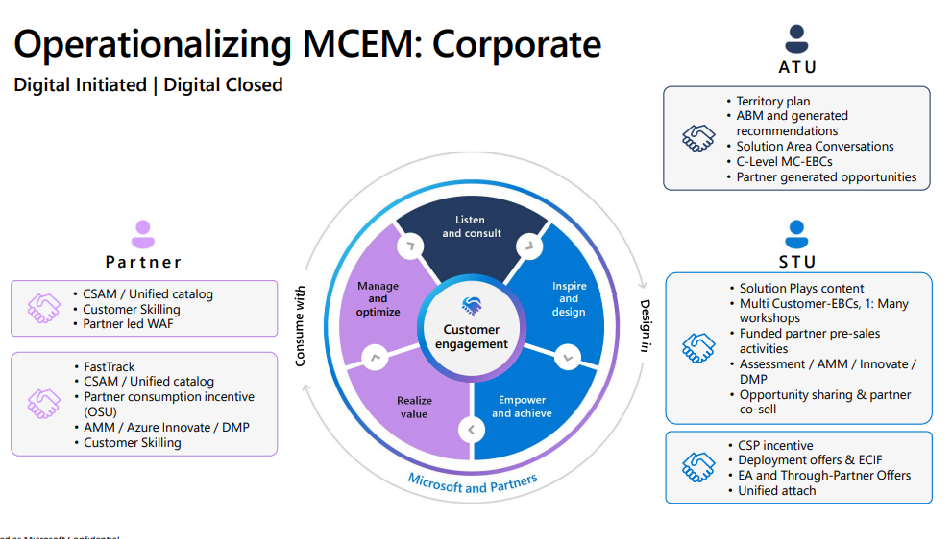
Microsoft sales process
ATU = AM
STU = DA/Practice/SEM

Slide 7
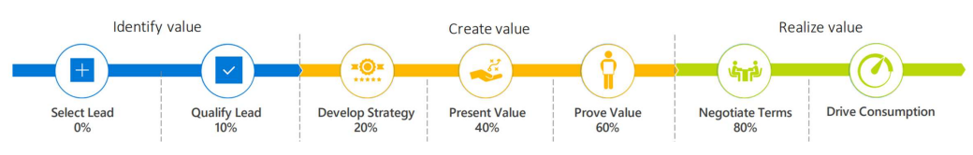
How can presales support CSP?
Marketing Top of Funnel/Data/Leads
Presales phase of customer journey
Project Delivery
Notes:
As we move to our new sales management methodology, LCEM, it is critical that we understand the different phases in a customer journey and act as a team to ensure that we capture all aspects of the incentives and offers MS has in place to help our customers accelerate their adoption.
Having an understanding of the key programs which map to the technologies which you support as a way to drive more pipeline, the data which uncovers deployment opportunities will also be important.

Slide 8
E5 Security Win Formula
Listen & Consult
Inspire & Design
Empower & Achieve
Realize Value
Manage & Optimize
Marketing
Propensity data Jumpstart program
Channel Sales target lists
Webinar attendee list
Act Now
FastTrack referral
ME3/ME5 1:1 Briefing
MCI Pilots
Readiness Assessment
ME3 CSP Promo
ECIF
(20:1 to 7:1 ROI ratio)
Fast Track Ready
MS Programs
Copilot Workshop
CSI Engagement
MW/Sec Usage Incentive
ME3 EA Ramp offer
Adoption Accelerator (E3/E5) 300 plus users post sales
ME3/ME5 1:many Briefing
ME5 Webinars
EBC
MTC events
Digital Content
Blog
Nurture activity
Long View Security Assessments:
Defender for Cloud Core (lighter scope)
Cloud Guard Controls (in-depth scope)
Azure DevOpps Assessment
SYNC Optimization
CSP Annual Upfront promo
Migrate to XDR Shield
Sentinel in 30
Entra in 30
DLP in 30
Copilot in 30
Copilot technical readiness
Running XDR Shield
Deployment services
LVS Offerings
AM/AA (CSP Squad)
SEM/Practice/DA/GTM/AM
GTM/SEM/CSP
DA/Practice/AM
Delivery/SOC
LVS roles
Notes:
Example Win Formula which helps break down the programs, our offering alignment to help through that phase from an LV resource. This is a team sport, at different phase different team members will take over the lead for that.
Example, once a CSI engagement is completed, both AM/DA assigned to account need to participate in review to map out the next steps and engage the right presales resource for the next phase

Slide 9
CSP is more than a licensing transaction
Customer
Access to Premier Support
End User Training via ClipTraining tools
Insights via Clear Report
CSP Team
Notes:
We get deep insights into the customer use by the different workloads which they purchase through the program. When we onboard
Why is it important that we land projects with customers via CSP? Premier, enhanced funding, CSP team access as from line to help navigate issues

